Slide 1
Statistical foundations of generalized dissimilarity models (GDMs)
GDM Workshop
Day 1
Instructor: Jacob Nesslage

Slide 2
Introduction
This week-long, intensive workshop is designed to build proficiency in and understanding of generalized dissimilarity modeling and its derivations – both in theory and practice through R programming.
Course Learning Objectives (CLO’s):
Develop an understanding of the statistical framework underpinning GDMs (i.e., distance matrices, matrix regression, I-splines, link functions, assumptions, and limitations).
Apply GDMs to community composition datasets to analyze and describe spatial patterns of compositional turnover using remote sensing and other raster-based datasets using R.
Explore extensions of GDMs for various purposes, such as Sparse Generalized Dissimilarity Modeling for high dimensional datasets (i.e., hyperspectral) and Multi-Site Generalized Dissimilarity Modeling for zeta diversity in R.

Slide 3
Workshop Logistics
Generally, the schedule each day will consist of:
Slides covering central concepts for the topic of each day
Paper discussions to reinforce the central concepts
Demos of GDM-related packages and concepts in R
Substantial time for application to your own datasets

Slide 4
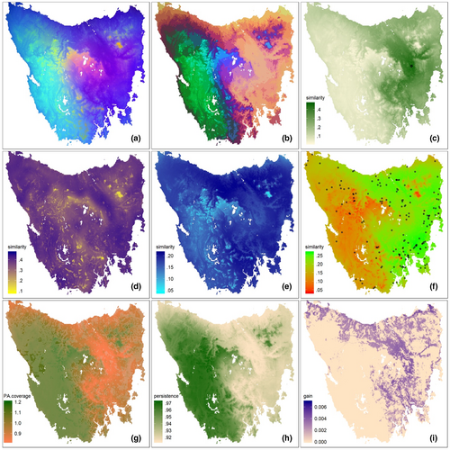
Why would we want to apply GDMs to our data?
Applications include:
Mapping compositional dissimilarity
Assessing the nonlinear influence of certain environmental predictors on dissimilarity
Testing “species sorting” related hypotheses
Assessing similarity of a focal community of interest in relation to others
Mapping refugia
Classification of habitat types
Partitioning geographic vs environmental effects on dissimilarity

Slide 5
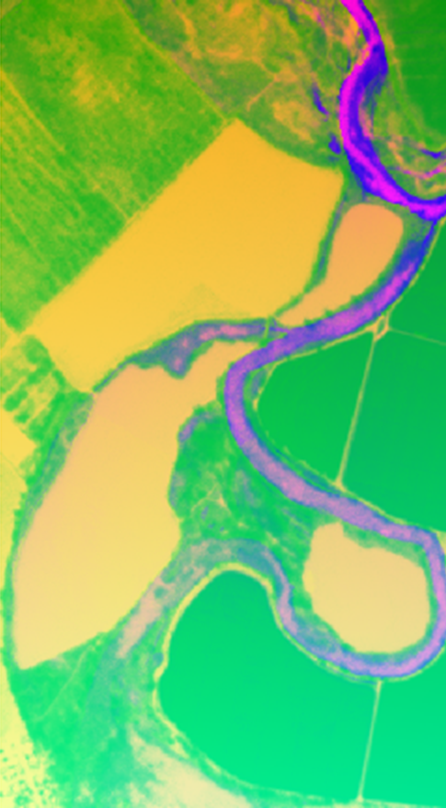
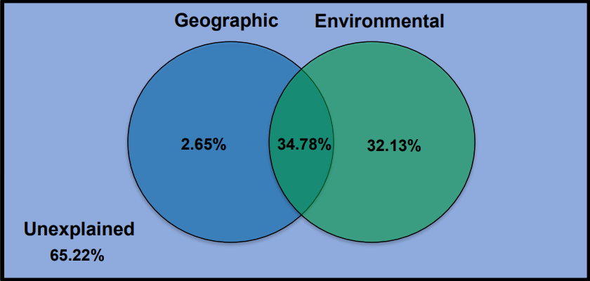
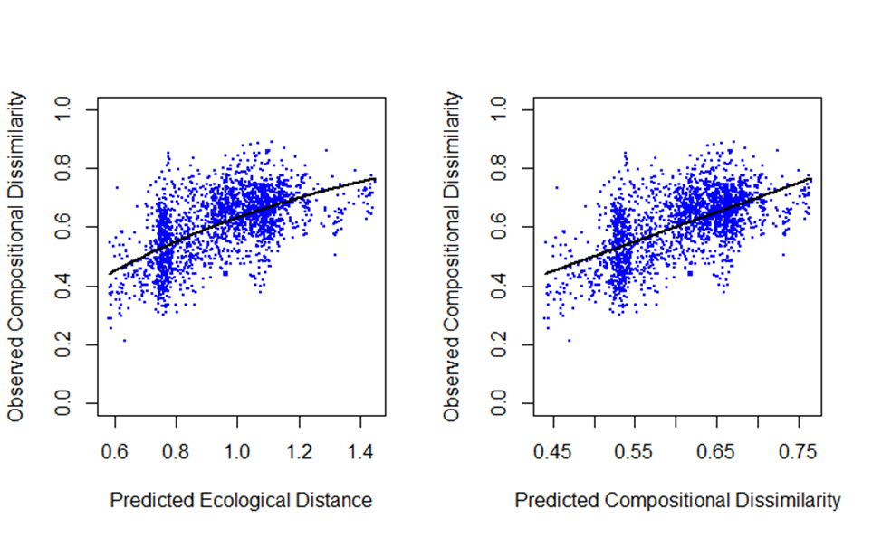
What are generalized dissimilarity models?
Generalized dissimilarity modelling (GDM) is a statistical technique for analyzing and predicting spatial patterns of turnover in community composition (beta diversity) from raster datasets.
The approach is designed specifically to accommodate two types of nonlinearity commonly encountered in large-scaled ecological data sets:
(1) the curvilinear relationship between increasing ecological distance and observed compositional dissimilarity between sites
(2) the variation in the rate of compositional turnover at different positions along environmental gradients.
Fitted GDM to FITS dataset at Grayson Riverbend Preserve using Planet SuperDove NDVI, MNF rotations, and airborne LiDAR as predictors.
(Nesslage et al. (unpublished))

Slide 6
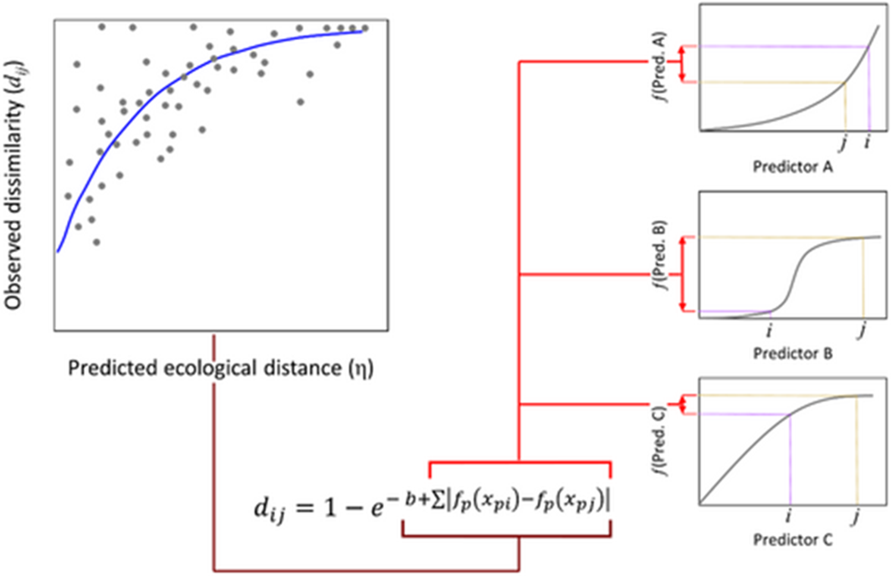
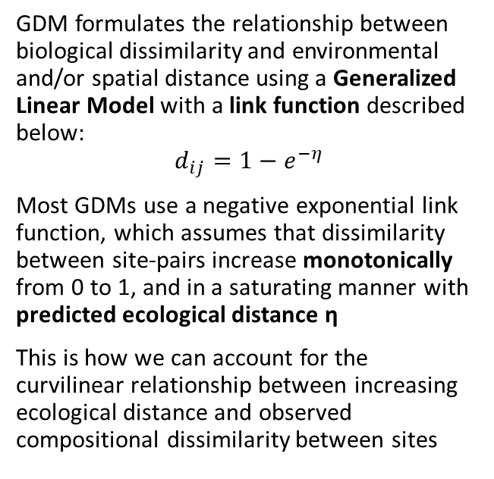
GDM Method
GDM formulates the relationship between biological dissimilarity and environmental and/or spatial distance using a Generalized Linear Model with a link function described below:
$$d_{ij}=1−e^{−η}$$
Most GDMs use a negative exponential link function, which assumes that dissimilarity between site-pairs increase monotonically from 0 to 1, and in a saturating manner with predicted ecological distance η
This is how we can account for the curvilinear relationship between increasing ecological distance and observed compositional dissimilarity between sites
Note the addition of a constant b to the exponential function, which represents dissimilarities at an ecological distance = 0
Mokany et al 2022 – Global Ecology and Biogeography

Slide 7

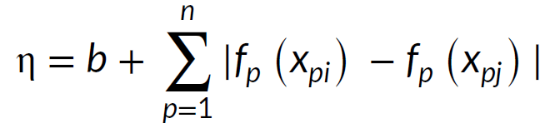
Ecological distance
The predicted ecological distance η is derived as the sum across all predictor variables of the absolute differences in the model transformed predictor values f_{p}(x_{p}) between sites i and j in a pair:
To transform each predictor variable, GDM uses a linear combination of I-spline basis functions fit using non-negative least squares regression.
Hence, the overall spline function f_{p}(x_{p}) for each predictor variable is relatively flexible in shape but constrained to increase monotonically. This constraint underlies a key assumption of GDM: that dissimilarity can only increase as two sites become more different in terms of the values of their predictor variables.
Mokany et al 2022 – Global Ecology and Biogeography

Slide 8
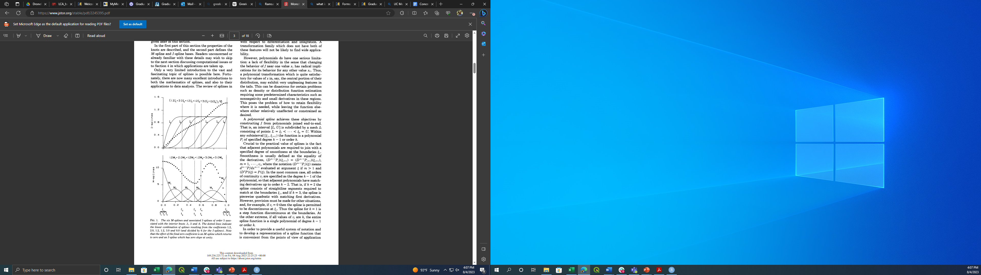
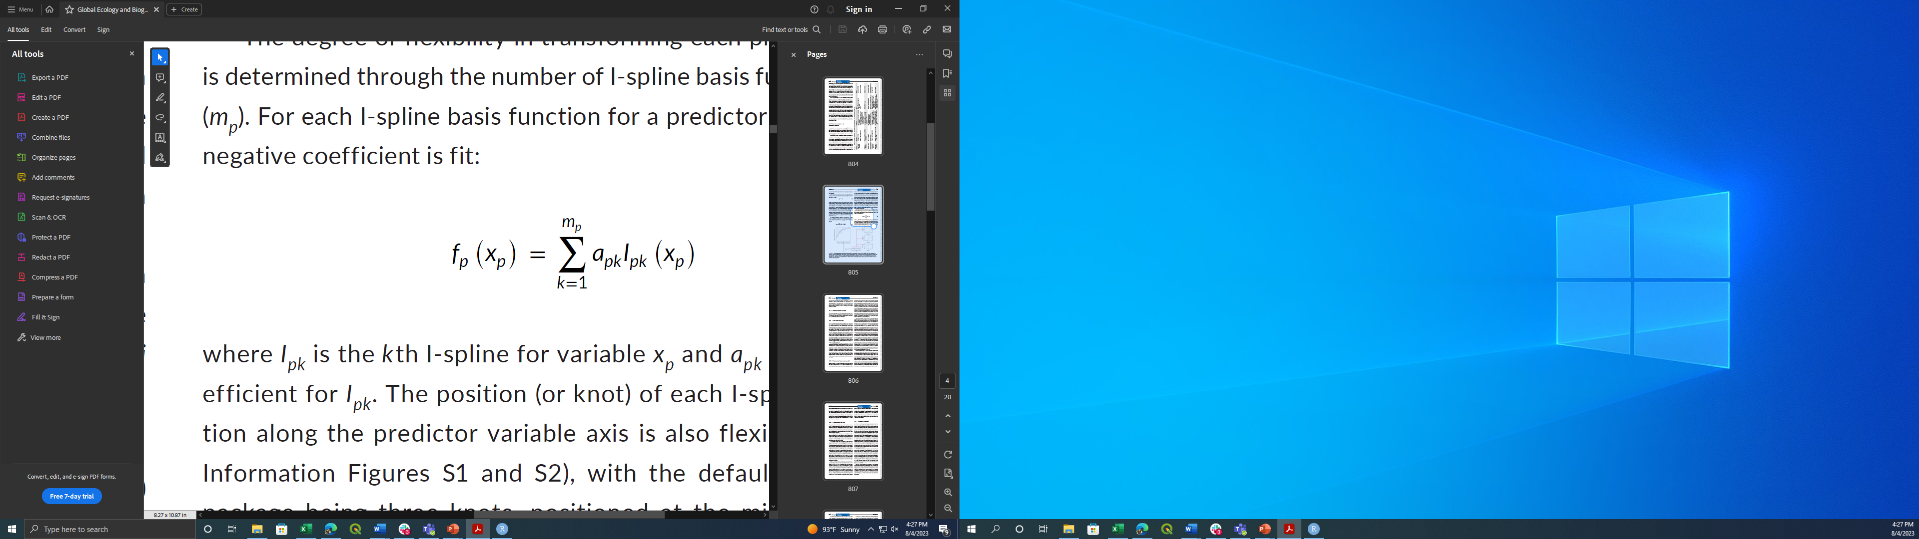
Wait, what are splines?
Transformed environmental variable
A spline is a series of piecewise polynomial functions, subdivided by knots, which allows one to overcome the limitations that a single polynomial function has in terms of flexibility of fit.
A monotonic spline function can be constructed from I-splines, the integral of M-splines fitted to a range of values, by taking the sum of a non-negative linear combination of I-splines and coefficients. This is expressed in GDMs as:
Environmental variable
Ramsey 1988 – Statistical Science

Slide 9
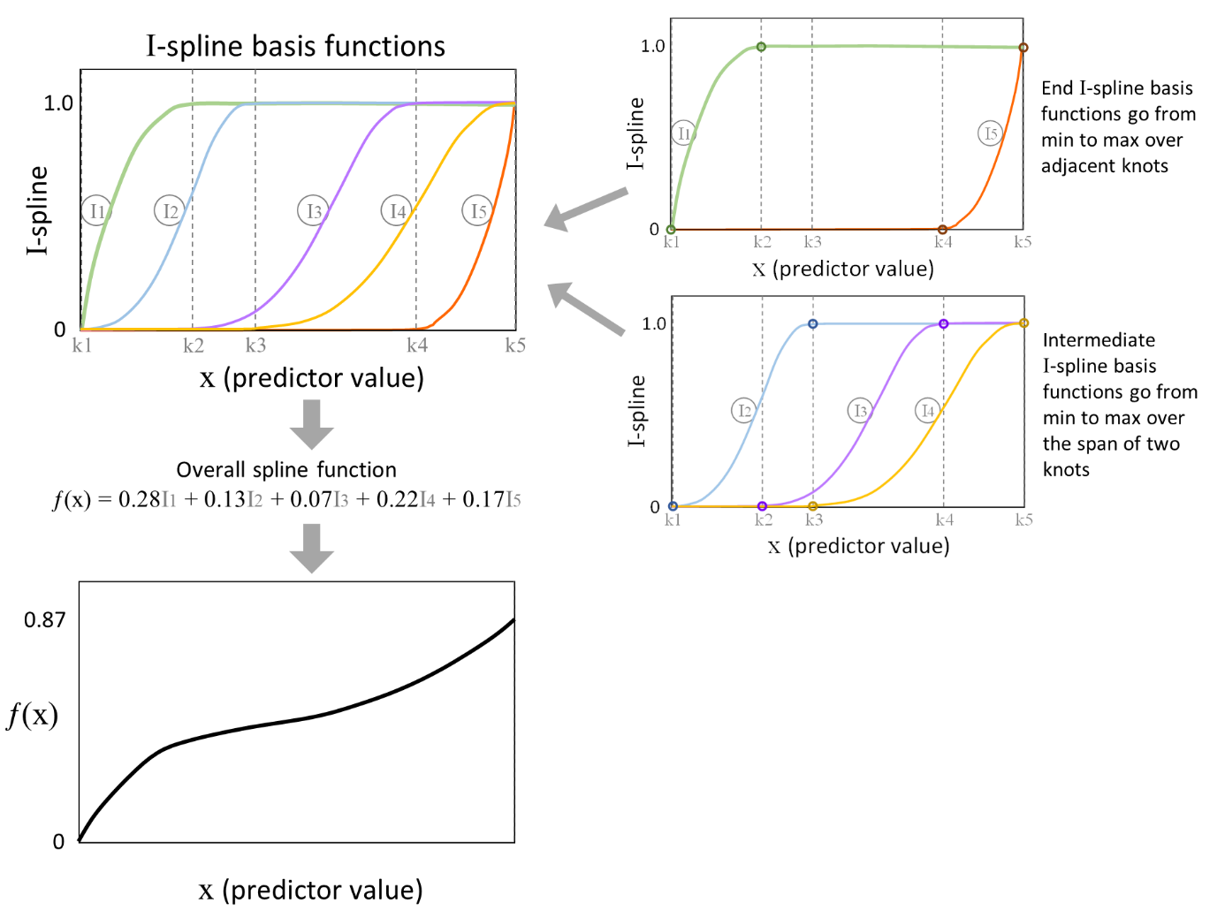
GDM I-spline example
Note: Standard knot configuration for gdm package is 3 – min, median, and max
Mokany et al 2022 – Global Ecology and Biogeography (Supplemental S2)

Slide 10
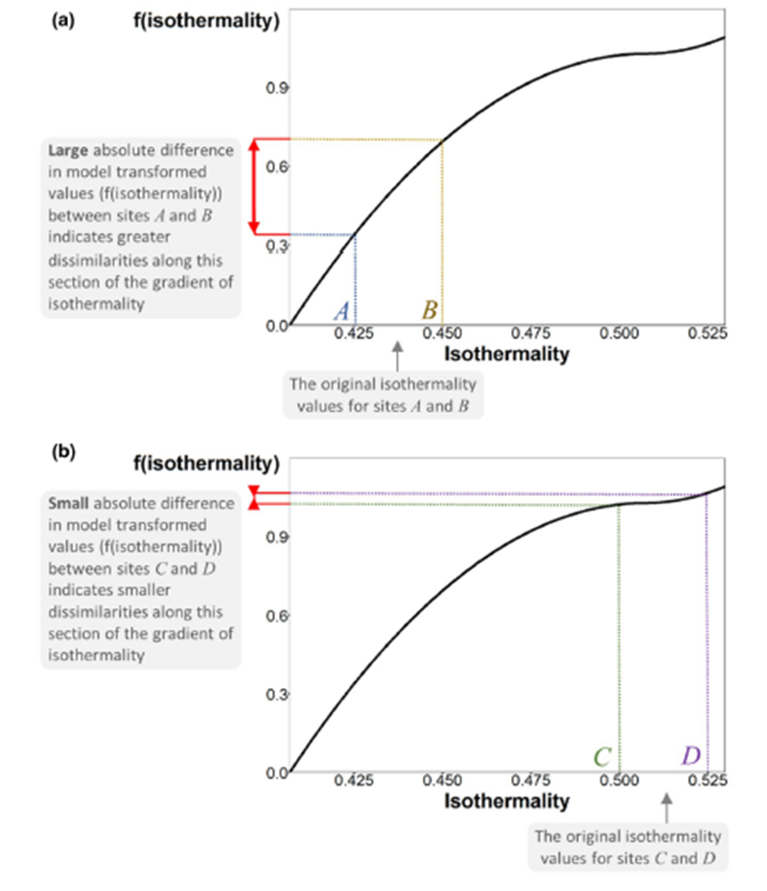
Transformation of predictor variables
As different predictors are measured on different scales in GDMs (e.g., temperature in degrees, precipitation in mm), they are transformed using I-splines as part of model fitting.
The transformation allows us to account for nonlinearities and variations along environmental gradients.
Mokany et al 2022 – Global Ecology and Biogeography

Slide 11
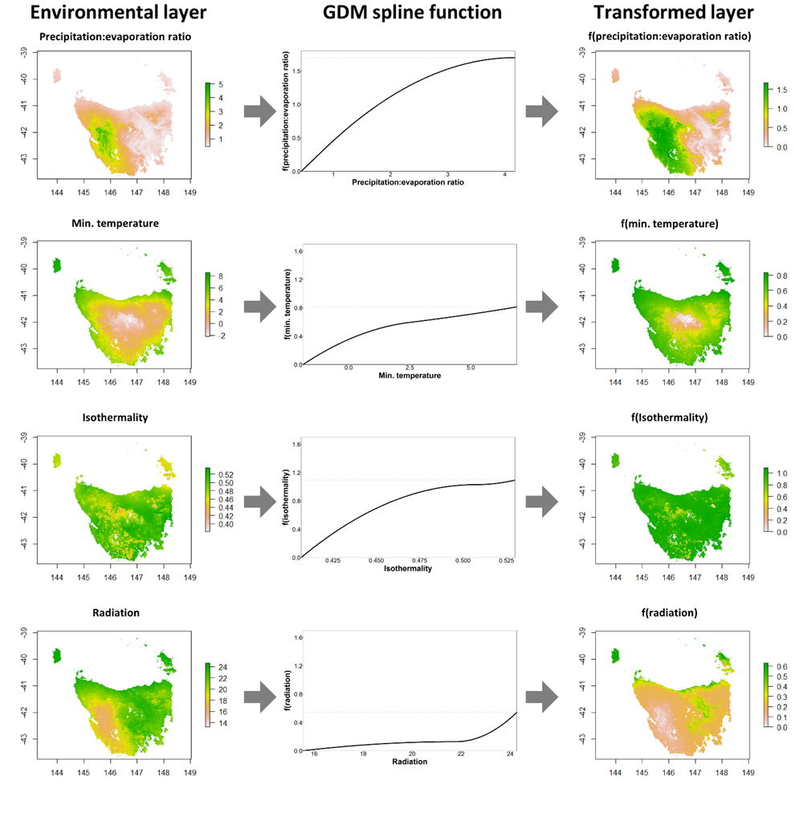
Transforming spatial data with I-splines
These transformations can also be applied to our raster data quite easily, allowing for spatial modeling
Mokany et al 2022 – Global Ecology and Biogeography (Supplemental S2)

Slide 12
Bringing the pieces of GDM all together
By assuming that increasing ecological distance, inferred through transformed raster data, must result in increasing dissimilarity monotonically, we can:
Preserve nonlinearity in the response of community dissimilarity to environmental variables
Account for the saturating effect of increasing ecological distance on dissimilarity
Extend models to spatial data easily
Mokany et al 2022 – Global Ecology and Biogeography

